Slide 1

SC2001 / ALGORITHM DESIGN AND ANALYSIS
Dijkstra’s
Algorithm
LAB 2
Gupta Dhruv
Gajulapalli Anish Reddy
Koh Jin En
SC2001 • PROJECT 2

Slide 2
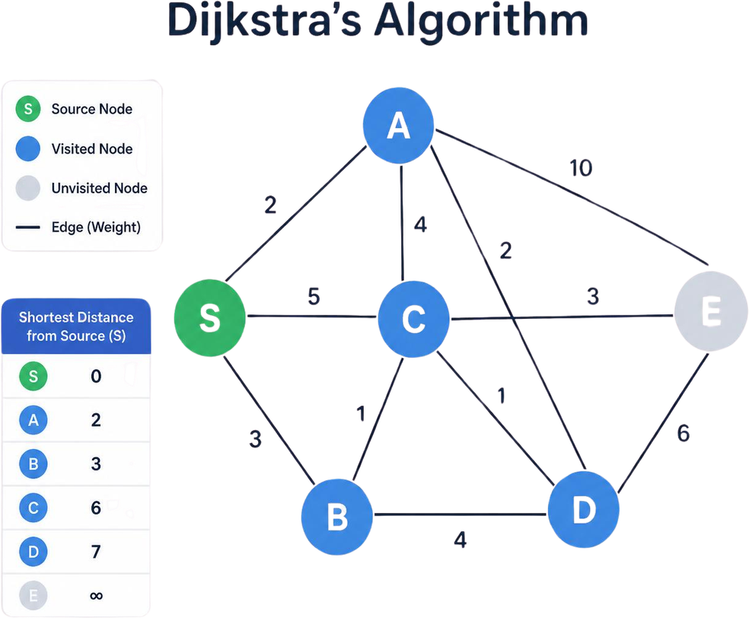
01
The question
Given one source.
Find shortest distance to every other vertex.
Dijkstra’s algorithm solves this for graphs with edge weights >=0.
However, its run time depends on how we store the graph information and select the next vertex to visit.
We go over 2 of its implementations and compare them to each other.
SC2001 • PROJECT 2

Slide 3
02A
Matrix + array / data structures
V×V Adjacency matrix
def find_nearest_unvisited_vertex(distances, visited):
smallest_distance = INFINITY
nearest_vertex = -1
for vertex in range(len(distances)):
if (not visited[vertex] and
distances[vertex] <smallest_distance):
smallest_distance = distances[vertex]
nearest_vertex = vertex
return nearest_vertex # O(V) scan every call
Each cell contains an edge weight representing distance between the 2 vertices,
“None” means there is no edge,
which allows “0” to remain a valid weight.
Priority queue
distances[] + visited[]
  distances: which stores the best known distances upto the current vertex. Starts by taking INFINITY distance to every node.
  visited: which tracks vertices already visited.
To go to the next nearest unvisited vertex,
we scan the entire distances array.
Each selection therefore takes O(V) time.
SC2001 • PROJECT 2

Slide 4
03A
Matrix + array / the main loop
Each iteration selects the nearest unvisited vertex and marks it as visited.
for step in range(number_of_vertices):
current_vertex = find_nearest_unvisited_vertex(distances, visited)
if current_vertex == -1:
break # rest are unreachable
visited[current_vertex] = True
for neighbour in range(number_of_vertices): # whole row: O(V)
edge_weight = adjacency_matrix[current_vertex][neighbour]
if edge_weight is None or visited[neighbour]:
continue
new_distance = distances[current_vertex] + edge_weight
if new_distance < distances[neighbour]:
distances[neighbour] = new_distance # O(1) update
previous[neighbour] = current_vertex
In each iteration, we scan the current node’s entire matrix row to find neighbours.
For each unvisited neighbour, we check whether travelling through the current vertex gives a shorter distance. If it does, we update the distance and the parent node.
SC2001 • PROJECT 2

Slide 5
04A
Matrix + array / complexity
There are at most V iterations.
Each performs an O(V) minimum selection, and an O(V) row scan.
Multiplying these gives
O(V^2) overall.
The adjacency matrix also requires
O(V^2) space.
Work per Iteration
Choosing nearest unvisited vertex: O(V)
Scan its matrix row: O(V)
Total per iteration: [O(V) + O(V)]
At most V iterations
Therefore, total runtime:
V × [O(V) + O(V)] = O(V²)
SC2001 • PROJECT 2

Slide 6
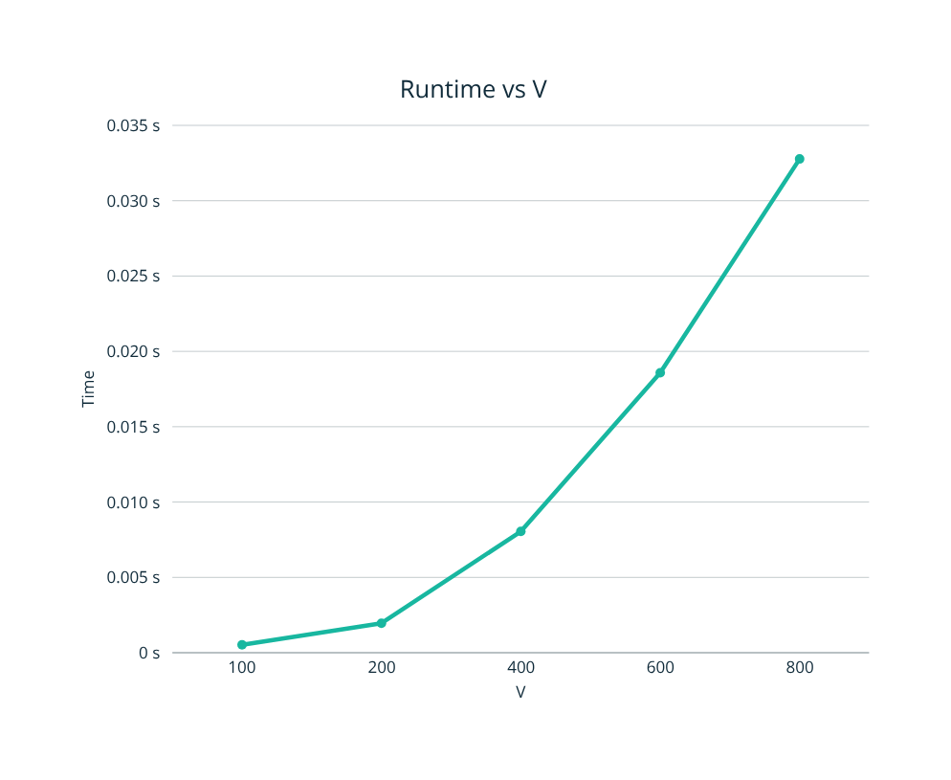
05A
Matrix + array / empirical results
Our tests support quadratic growth.
As V increases, time by V squared stays close to five x 10^-8
≈ 5 × 10⁻⁸
Time / V²
With V fixed at 500, increasing the number of edges by approximately 90 times increases runtime by only 1.37 times.
This shows that vertex count dominates this implementation’s runtime, because it scans the full matrix regardless of how many edges exist.
FIXED V = 500
90× edges→
only 1.37× time
SC2001 • PROJECT 2

Slide 7
06B
Lists + min-heap / data structures
adjacency_list[u]
Heap operation
Cost
Stores only real (v, weight) pairs.
insert
O(log V)
extract_min
O(log V)
Binary MinHeap + position[]
decrease_key
O(log V)
position[v] gives v’s heap index in O(1).
contains
O(1)
SC2001 • PROJECT 2

Slide 8
07B
Lists + min-heap / the main loop
while not heap.is_empty():
current_vertex, current_distance = heap.extract_min()
if current_distance == INFINITY:
break # rest are unreachable
for neighbour, edge_weight in adjacency_list[current_vertex]:
if not heap.contains(neighbour):
continue # distance already final
new_distance = current_distance + edge_weight
if new_distance < distances[neighbour]:
distances[neighbour] = new_distance
previous[neighbour] = current_vertex
heap.decrease_key(neighbour, new_distance)
1×
each vertex extracted
Only real edges are scanned.
SC2001 • PROJECT 2

Slide 9
08B
decrease_key / the position array
def decrease_key(self, vertex, new_key):
index = self.position[vertex] # O(1) lookup
self.keys[index] = new_key
self.sift_up(index) # O(log V)
def sift_up(self, index):
while index > 0:
parent = (index - 1) // 2
if self.keys[parent] <= self.keys[index]:
break
self.swap(index, parent) # also updates position[]
index = parent
Without position[]
O(V)
With position[]
O(1) lookup
SC2001 • PROJECT 2

Slide 10
09B
Lists + min-heap / theoretical complexity
V extracts
E relaxations
V log V
E log V
O((V + E) log V)
SC2001 • PROJECT 2

Slide 11
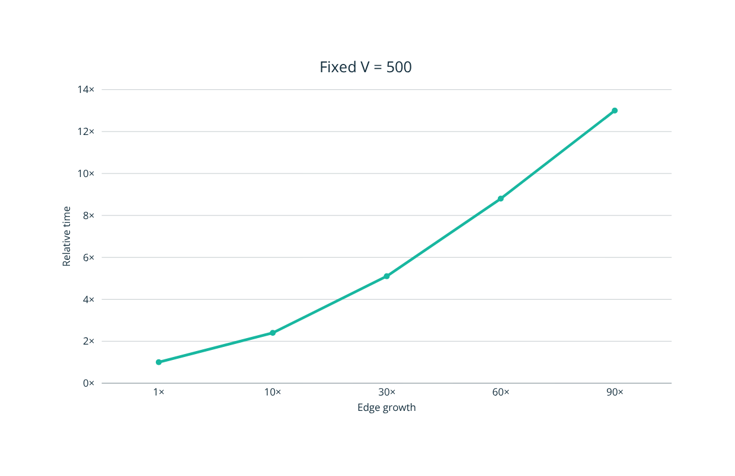
10B
Lists + min-heap / empirical results
90× edges
→ 13× time
V = 50,000
0.90 s
when E = 5V
SC2001 • PROJECT 2

Slide 12
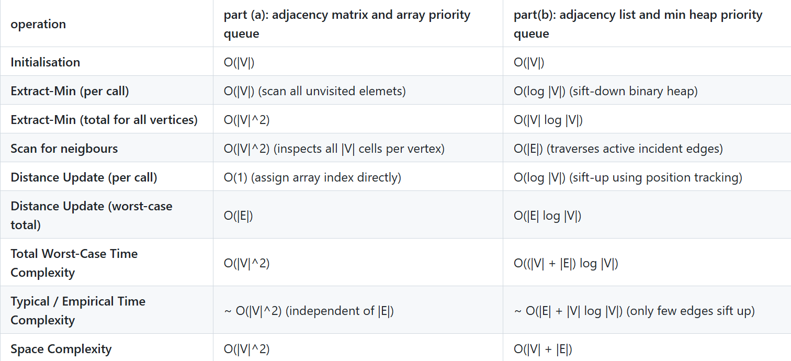
11C
Theory / side by side
SC2001 • PROJECT 2

Slide 13
12C
fixed |V| at 500, |E| increases
Density
|E|
Part (a) time (s)
Part (b) time (s)
Faster
1%
1,247
0.01237
0.00124
(b), ~10x faster
10%
12,475
0.01320
0.00493
(b), ~2.7x faster
25%
31,187
0.01467
0.01313
(b), ~1.1x faster
50%
62,375
0.01820
0.02153
(a), ~1.2x faster
75%
93,562
0.01919
0.02424
(a), ~1.3x faster
90%
112,275
0.01998
0.02490
(a), ~1.2x faster
100%
124,750
0.02104
0.02580
(a), ~1.2x faster
Both parts run on the same laptop, on identical graphs (average of 5 runs). The lines cross at about 33% density.
SC2001 • PROJECT 2

Slide 14
12C
fixed density ~25%, |V| increases
|V|
|E| (~25%)
Part (a) time (s)
Part (b) time (s)
Faster
100
1,237
0.000576
0.000320
(b), ~1.8x faster
200
4,975
0.002259
0.000974
(b), ~2.3x faster
400
19,950
0.009648
0.005830
(b), ~1.7x faster
600
44,925
0.022774
0.017839
(b), ~1.3x faster
800
79,900
0.038653
0.033799
(b), ~1.1x faster
Same laptop, same graphs. At 25% density (b) stays ahead, but the gap narrows as V grows.
SC2001 • PROJECT 2

Slide 15
13C
Memory / the hard limit
V (E = 5V)
Matrix entries (part a)
List entries (part b)
500
5002 = 250,000
500 + 2 (2500) = 5,500
5,000
50002 = 25,000,000
5000 + 2(25 000) = 55,000
50,000
500002 = 2,500,000,000
50000 + 2(250000) = 550,000
At V = 500 ⟶ both run easily
At |V| = 5000 ⟶ both run
At |V| = 50000 ⟶ matrix allocation fails but list completes in 0.90s
SC2001 • PROJECT 2

Slide 16
14C
Which one should you use?
MATRIX + ARRAY
LISTS + HEAP
Dense graphs
Large or sparse graphs
On the same laptop, (a) wins once density passes about 33% (around 1.2–1.3× faster at |V| = 500).
For dense graphs (|E| ≈ |V|²), (a) only does O(|V|²) cheap array checks, while (b) traverses O(|E|) list entries plus heap work, worst case O(|V|² log |V|).
For large graphs (|V| ≥ 1000 up to |V| = 50,000 and beyond), Part (b) scales linearly to |V| = 50,000 (0.90s), whereas Part (a) becomes impractical past |V| ≈ 1,000 due to quadratic memory growth Θ(|V|2).
For sparse graphs (|E| << |V|), When vertices have a limited degree (for eg. |E| ≈ O(|V|) ), Part (b) O(|E| log |V|) complexity completely outperforms the Θ(|V|2) matrix scan.
SC2001 • PROJECT 2

Slide 17
14C
How Code Simplicity and Constant Costs Affect Measured Results
Time (ms), V = 500, same laptop
30
V
crossover ≈ 33%
part a
contiguous array and low constant factor
20
vs
10
● (b) Lists + min-heap
part b
● (a) Matrix + array
list traversal and high constant factor
0
0%
25%
50%
75%
100%
Graph density
SC2001 • PROJECT 2

Slide 18
Thank you.
Gupta Dhruv
Gajulapalli Anish Reddy Koh Jin En
SC2001 • PROJECT 2

